Slide 1
2.8 Rule Utilitarianism
1-<number>

Slide 2
Applying Principle of Utility to Rules
We ought to adopt moral rules which, if followed by everyone, will lead to the greatest increase in total happiness
Act utilitarianism applies Principle of Utility to individual actions
Rule utilitarianism applies Principle of Utility to moral rules
1-<number>

Slide 3
Anti-Worm Scenario
August 2003: Blaster worm infected thousands of Windows computers
Soon after, Nachi worm appeared
  Took control of vulnerable computer
  Located and destroyed copies of Blaster
  Downloaded software patch to fix security problem
  Used computer as launching pad to try to “infect” other vulnerable PCs
1-<number>

Slide 4
Evaluation using Rule Utilitarianism
Proposed rule: If I can write a helpful worm that removes a harmful worm from infected computers and shields them from future attacks, I should do so
Who would benefit
  People who do not keep their systems updated
Who would be harmed
  People who use networks
  People who’s computers are invaded by buggy anti-worms
  System administrators
Conclusion: Harm outweighs benefits. Releasing anti-worm is wrong.
1-<number>

Slide 5
Case for Rule Utilitarianism
Not every moral decision requires performing utilitarian calculus
Moral rules survive exceptional situations
Avoids the problem of moral luck
Reduces the problem of bias
Appeals to a wide cross-section of society
1-<number>
Notes:
Rule utilitarianism looks at whether an action would be acceptable if everyone did it.

Slide 6
Case Against Utilitarianism in General
All consequences must be measured on a single scale.
  All units must be the same in order to do the sum
  In certain circumstances utilitarians must quantify the value of a human life
Utilitarianism ignores the problem of an unjust distribution of good consequences.
  Utilitarianism does not mean “the greatest good of the greatest number”
  That requires a principle of justice
  What happens when a conflict arises between the Principle of Utility and a principle of justice?
Despite weaknesses, both act utilitarianism and rule utilitarianism are workable ethical theories
1-<number>

Slide 7
2.9 Social Contract Theory
1-<number>

Slide 8
Basis of Social Contract Theory
Thomas Hobbes
  In a “state of nature” our lives would be “solitary, poore, nasty, brutish, and short”
  We implicitly accept a social contract
    Establishment of moral rules to govern relations among citizens
    Government capable of enforcing these rules
Jean-Jacques Rousseau
  In ideal society, no one above rules
  That prevents society from enacting bad rules
1-<number>

Slide 9
James Rachels’s Definition
“Morality consists in the set of rules,
governing how people are to
treat one another, that rational
people will agree to accept, for their
mutual benefit, on the condition that
others follow those rules as well.”
1-<number>

Slide 10
Kinds of Rights
Negative right: A right that another can guarantee by leaving you alone
Positive right: A right obligating others to do something on your behalf
Absolute right: A right guaranteed without exception
Limited right: A right that may be restricted based on the circumstances
1-<number>

Slide 11
Correlation between Types of Rights
Positive rights tend to be more limited
Negative rights tends to be more absolute
1-<number>

Slide 12
John Rawls’s Principles of Justice
Each person may claim a “fully adequate” number of basic rights and liberties, so long as these claims are consistent with everyone else having a claim to the same rights and liberties
Any social and economic inequalities must
  Be associated with positions that everyone has a fair and equal opportunity to achieve
  Be to the greatest benefit of the least-advantaged members of society (the difference principle)
1-<number>
Notes:
Treat everyone equally!

Slide 13
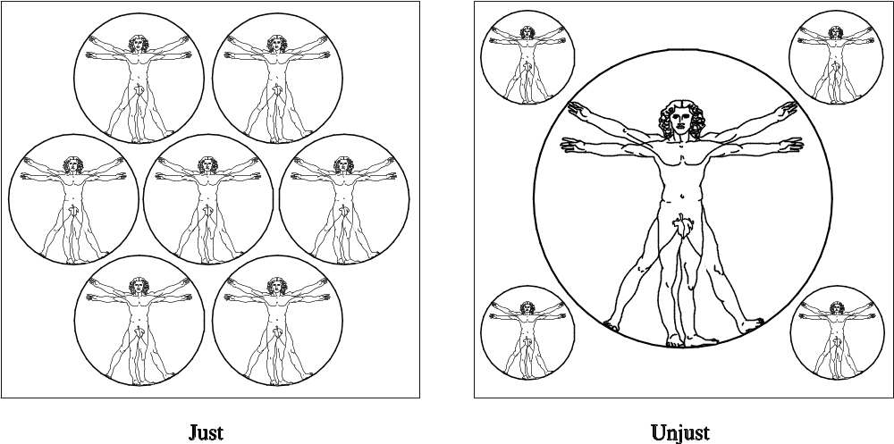
Rawls’s First Principle of Justice
1-<number>

Slide 14
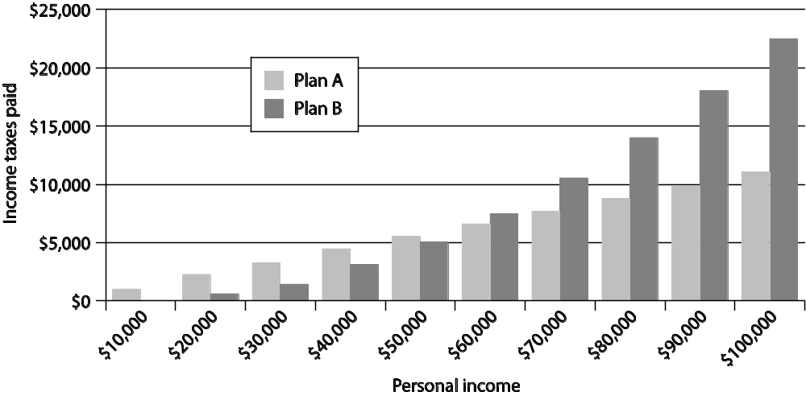
Rawls’s Difference Principle
1-<number>
Notes:
We do not treat everyone equally in all cases like in interview, terminal marks allocation.

Slide 15
DVD Rental Scenario
Bill owns chain of DVD rental stores
Collects information about rentals from customers
Constructs profiles of customers
Sells profiles to direct marketing firms
Some customers happy to receive more mail order catalogs; others unhappy at increase in “junk mail”
1-<number>

Slide 16
Evaluation (Social Contract Theory)
Consider rights of Bill, customers, and mail order companies.
Does customer have right to expect name, address to be kept confidential?
If customer rents DVD from bill, who owns information about transaction?
If Bill and customer have equal rights to information, Bill did nothing wrong to sell information.
If customers have right to expect name and address or transaction to be confidential without giving permission, then Bill was wrong to sell information without asking for permission.
1-<number>

Slide 17
Case for Social Contract Theory
Framed in language of rights
Explains why people act in self-interest in absence of common agreement
Provides clear analysis of certain citizen/government problems
  Why okay for government to deprive criminals of certain rights
  Why civil obedience can be morally right action
Workable ethical theory
1-<number>

Slide 18
Case Against Social Contract Theory
No one signed social contract
Some actions have multiple characterizations
Conflicting rights problem
May unjustly treat people incapable of upholding contract
Despite weaknesses, a workable theory
1-<number>

Slide 19
2.10 Virtue Ethics
1-<number>

Slide 20
Critique of Enlightenment Theories
Kantianism, utilitarianism, social contract theory ignore important moral considerations
  moral education
  moral wisdom
  family and social relationships
  role of emotions
Virtue ethics
  arete, virtue, excellence: reaching highest potential
  Aristotle’s Nicomachean Ethics (4th century BC)
1-<number>

Slide 21
Virtues and Vices
Two types of virtue
  intellectual virtues: virtues associated with reasoning and truth
  moral virtues: virtues of character (e.g., honesty)
Moral virtues
  developed by habitually performing right action
  deep-seated character traits
  disposition to act in a certain way and feel in a certain way
1-<number>

Slide 22
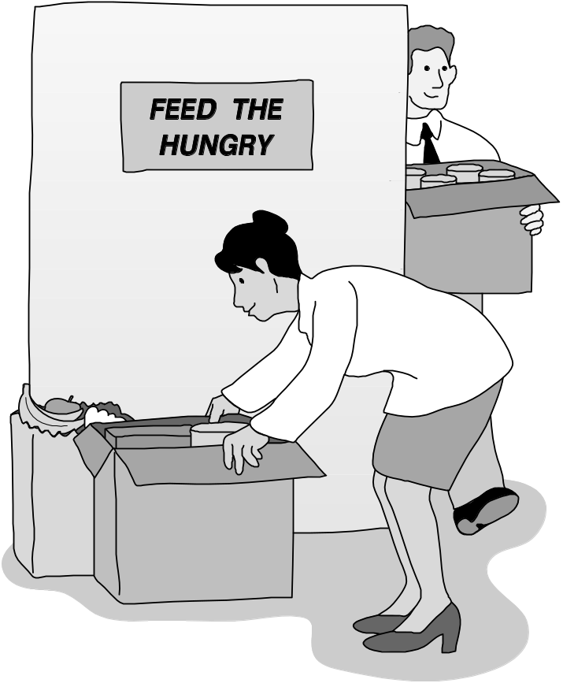
Aristotle: Happiness derives from living a life of virtue.
1-<number>

Slide 23
Summary of Virtue Ethics
A right action is an action that a virtuous person, acting in character, would do in the same circumstances.
A virtuous person is a person who possesses and lives out the virtues.
The virtues are those character traits human beings needs in order to flourish and be truly happy.
1-<number>

Slide 24
Vices
Vices are opposite of virtues
Vice: a character trait that prevents a human being from flourishing or being truly happy
Often, a virtue situated between two vices
  Courage between cowardliness and rashness
  Generosity between stinginess and prodigality
1-<number>

Slide 25
Case for Virtue Ethics
It often makes more sense to focus on virtues than obligations, rights, or consequences
Personal relationships can be morally relevant to decision making
Our moral decision-making skills develop over time
With this theory there are no irresolvable moral dilemmas
Emotions play an important role in living a moral life
1-<number>

Slide 26
Case Against Virtue Ethics
Reasonable people may disagree on character traits needed for human flourishing
Cannot use virtue ethics to guide government policy
Virtue ethics undermines attempts to hold people responsible for their bad actions
Despite weaknesses, virtue ethics a workable theory
1-<number>

Slide 27
2.11 Comparing Workable Ethical Theories
1-<number>

Slide 28
Objectivism vs. Relativism
Objectivism: Morality has an existence outside the human mind
Relativism: Morality is a human invention
Divine command theory, ethical egoism, Kantianism, utilitarianism, social contract theory, and virtue ethics examples of objectivism
1-<number>

Slide 29
Workable Ethical Theories
We seek theories with these characteristics:
  Based on the ethical point of view
  Objective moral principles developed using logical reasoning based on facts and commonly held values
Workable ethical theories
  Kantianism
  Act and rule utilitarianism
  Social contract theory
  Virtue ethics
1-<number>

Slide 30
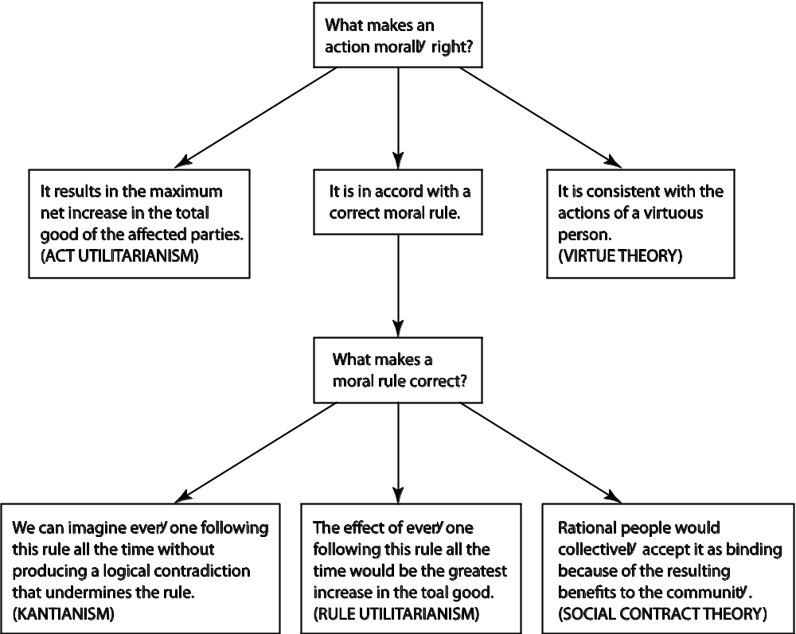
Comparing Workable Ethical Theories
1-<number>

Slide 31
2.12 Morality of Breaking the Law
1-<number>

Slide 32
Social Contract Theory Perspective
Everyone in society bears certain burdens in order to receive certain benefits
Legal system supposed to guarantee people’s rights are protected
Everything else being equal, we should be law-abiding
Should only break law if compelled to follow a higher-order moral obligation
1-<number>

Slide 33
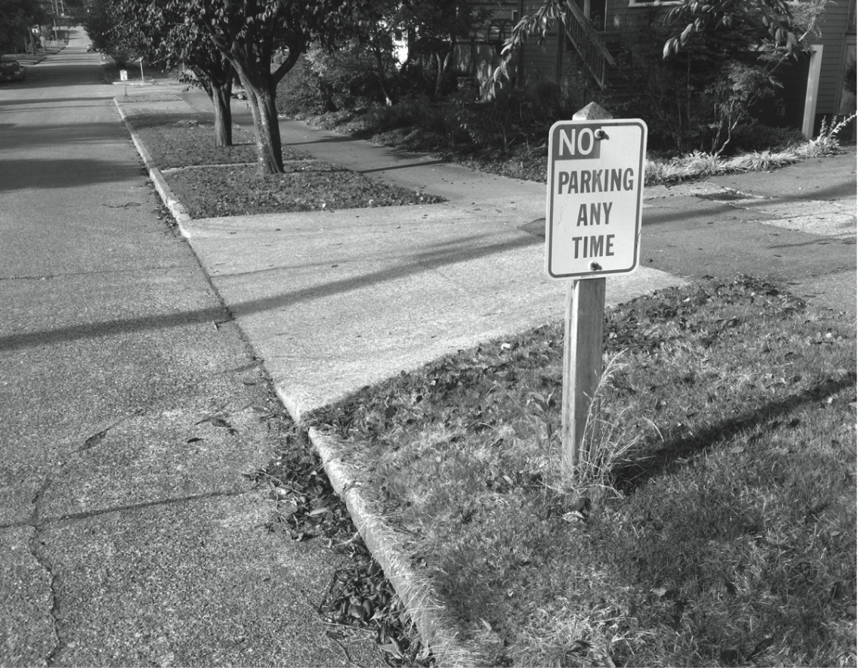
Social Contract: A Prima Facie Obligation to Obey the Law
1-<number>

Slide 34
Kantian Perspective
Everyone wants to be treated justly
Imagine rule: “I may break a law I believe to be unjust”
If everyone acted according to this rule, then laws would be subverted
Contradiction: Cannot both wish to be treated justly and allow laws to be subverted
1-<number>

Slide 35
Rule Utilitarian Perspective
What would be consequences of people ignoring laws they felt to be unjust?
Beneficial consequence: Happiness of people who are doing what they please
Harmful consequences: Harm to people directly affected by lawless actions, general loss of respect for laws, increased burden on criminal justice system
Harms greater than benefits
1-<number>

Slide 36
Act Utilitarian Perspective
Possible to conceive of situations where benefits of breaking law exceed harms
Suppose give penniless, bedridden friend copy of CD
Friend benefits by $15 (value of CD)
I benefit by $10 (satisfaction of helping friend)
Harms of $0 (no lost sale, no police involvement)
With $25 of benefit and $0 of harm, action is determined to be good
1-<number>

Slide 37
Summary
1-<number>

Slide 38
Insights Offered by Various Theories
Kantianism: Every person is equally valuable, and when you interact with other people you should always respect them as rational beings.
Utilitarianism: You should consider the consequences of an action before deciding whether it’s right or wrong.
Social contract theory: We should collectively promote human rights, such as the rights to life, liberty, and property.
Virtue ethics: You can count on a good person to do the right thing at the right time in the right way.
1-<number>

Slide 39
It’s Up to You
You can consider duties and rights and consequences and virtues when making moral decisions
Ultimately, you have to decide:
  What kind of person do I want to be?
  What kind of world do I want to live in?
1-<number>

